Slide 1

Model representation
Linear regression with one variable
Machine Learning

Slide 2
Housing Prices
(Portland, OR)
Price
(in 1000s of dollars)
220K
1200
Size (feet²)
Supervised Learning
Given the “right answer” for each example in the data.
Regression Problem:
Predict real-valued output
Classification: discrete-valued output

Slide 3
Training set of
housing prices
(Portland, OR)
Size in feet² (x) | Price ($) in 1000's (y)
2104 | 460
1416 | 232
1534 | 315
852 | 178
… | …
Notation:
m = Number of training examples
x’s = “input” variable / features
y’s = “output” variable / “target” variable
m | 4
x⁽¹⁾ | 2104
x⁽²⁾ | 1416
y⁽¹⁾ | 460
(x,y): one training example
(x^{(i)},y^{(i)}): ith traning example

Slide 4

Training Set
How do we represent h ?
Hypothesis:
Learning Algorithm
Size of house
h
Estimated price
Linear regression with one variable.
Univariate linear regression (only one variable).
$$h:x→y$$

Slide 5
Cost function
Linear regression with one variable
Machine Learning

Slide 6
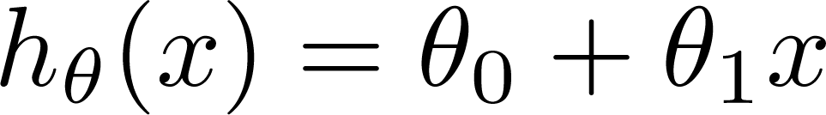

Training Set
Size in feet² (x) | Price ($) in 1000's (y)
2104 | 460
1416 | 232
1534 | 315
852 | 178
… | …
Hypothesis:
‘s: Parameters
How to choose ‘s ?

Slide 7
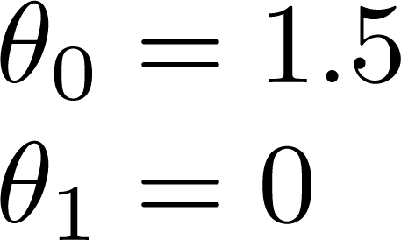
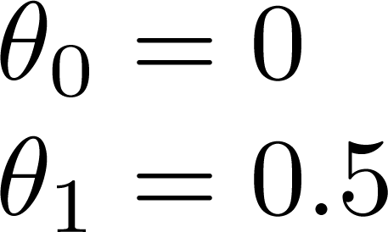
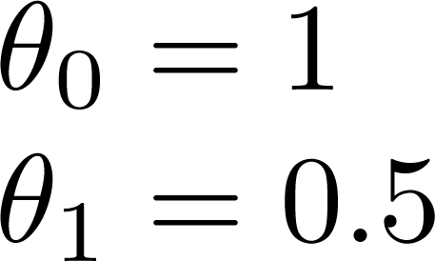

Slide 8
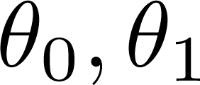


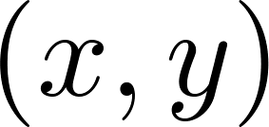
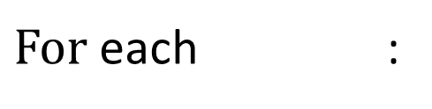

$$Cost function:$$
y
$For$ each :
x
Idea: Choose so that is close to for our training examples

Slide 9
Cost function intuition
Linear regression with one variable
Machine Learning

Slide 10
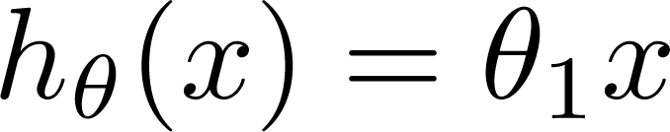

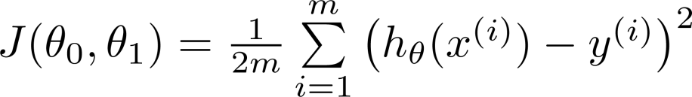
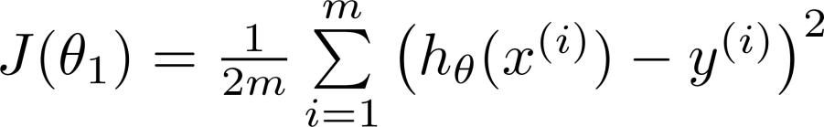
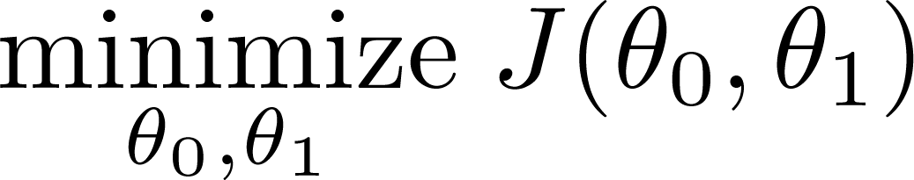
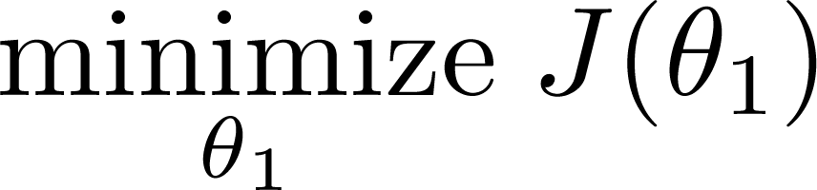
Simplified
Hypothesis:
Parameters:
Cost Function:
Goal:

Slide 11






(for fixed , this is a function of x)
(function of the parameter )
y
x

Slide 12

(for fixed , this is a function of x)
(function of the parameter )
y
x

Slide 13
(for fixed , this is a function of x)
(function of the parameter )
y
x

Slide 14
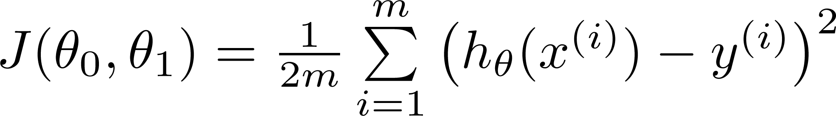

$${when θ}_{0}≠0,$$
Hypothesis:
Parameters:
Cost Function:
Goal:

Slide 15

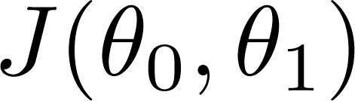

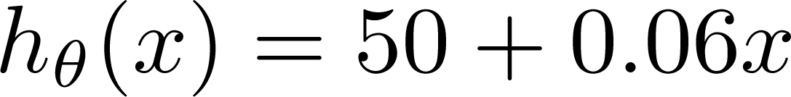
(for fixed , this is a function of x)
(function of the parameters )
Price ($)
in 1000’s
curve？
Size in feet² (x)

Slide 16
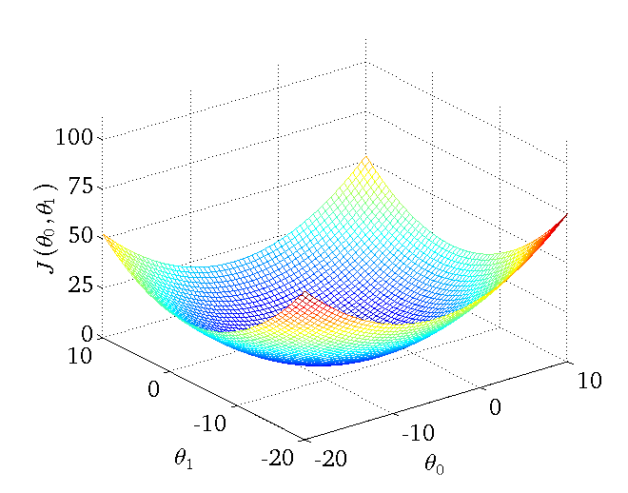

Slide 17
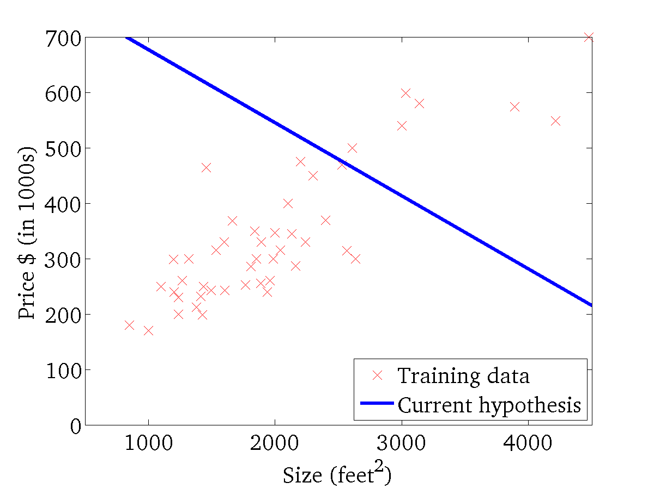
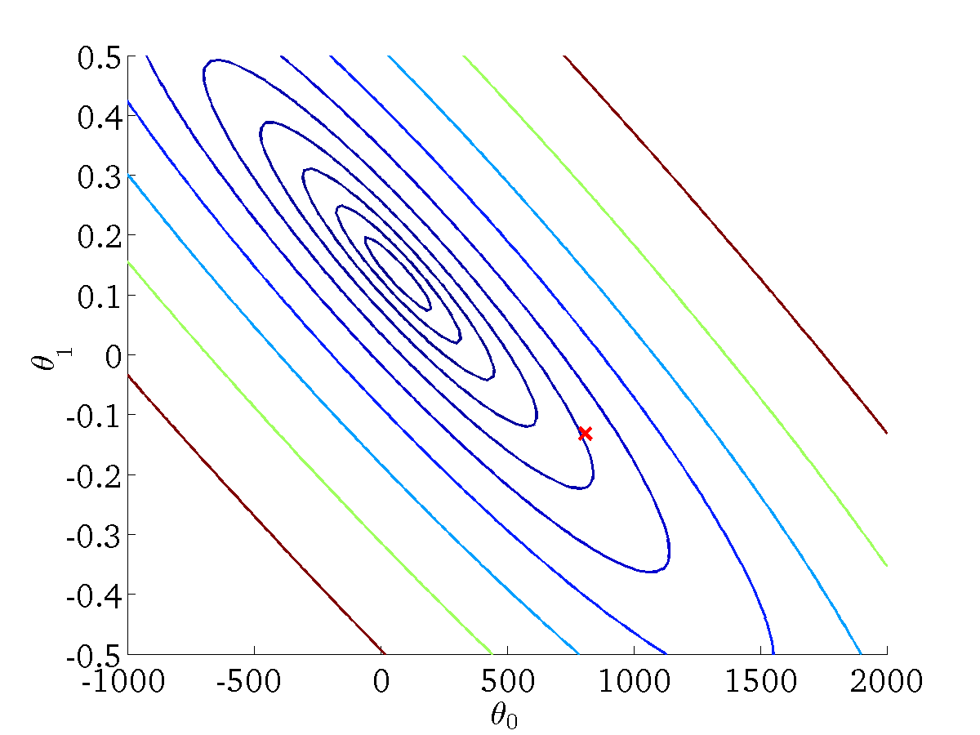
(for fixed , this is a function of x)
(function of the parameters )

Slide 18
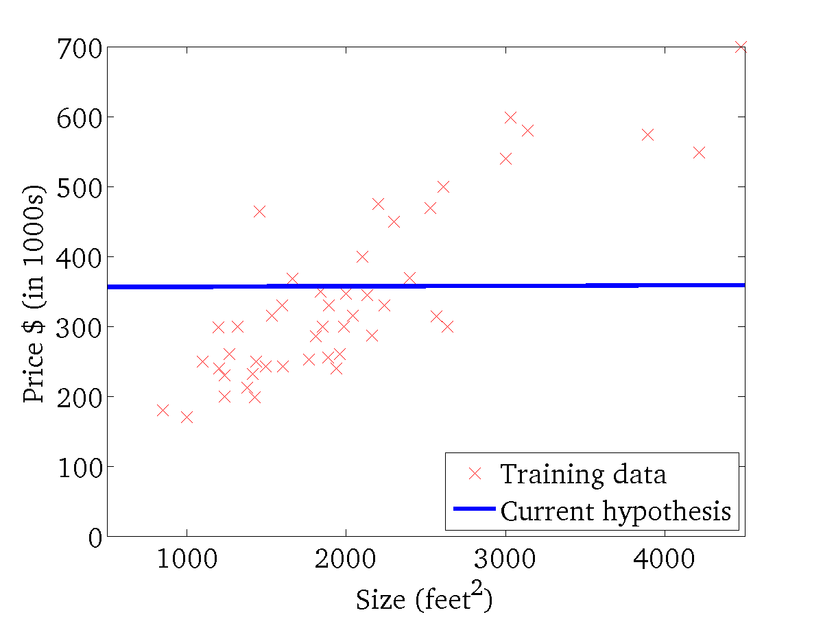
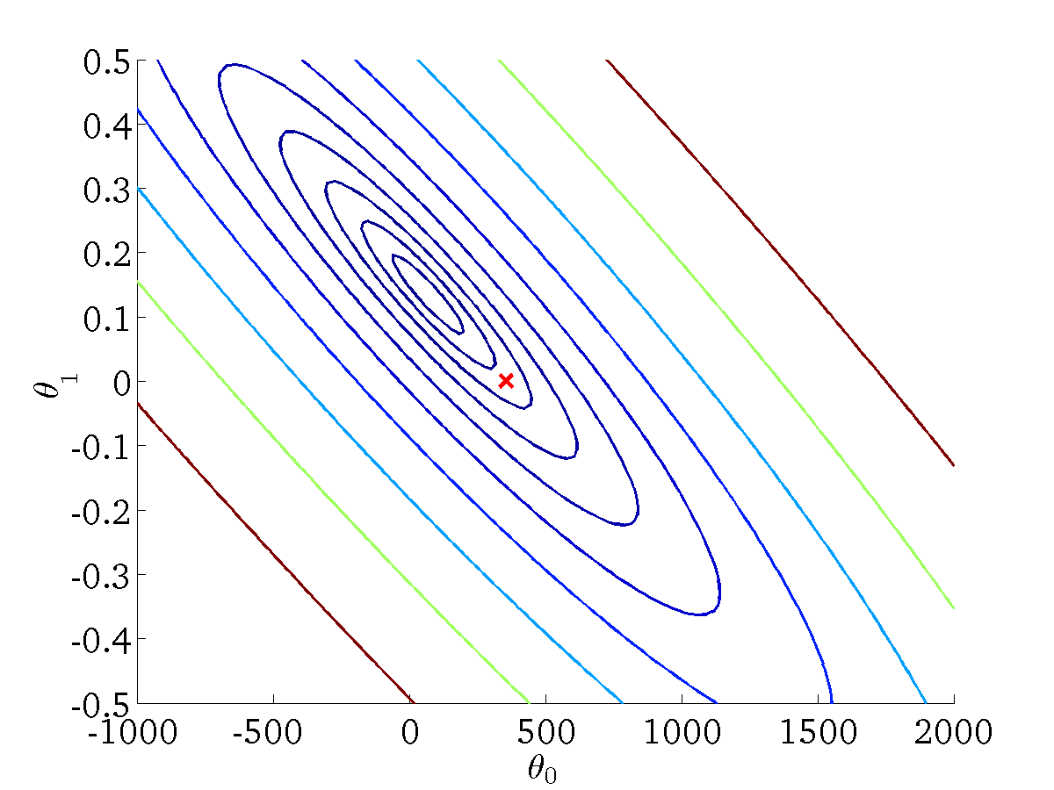
(for fixed , this is a function of x)
(function of the parameters )

Slide 19
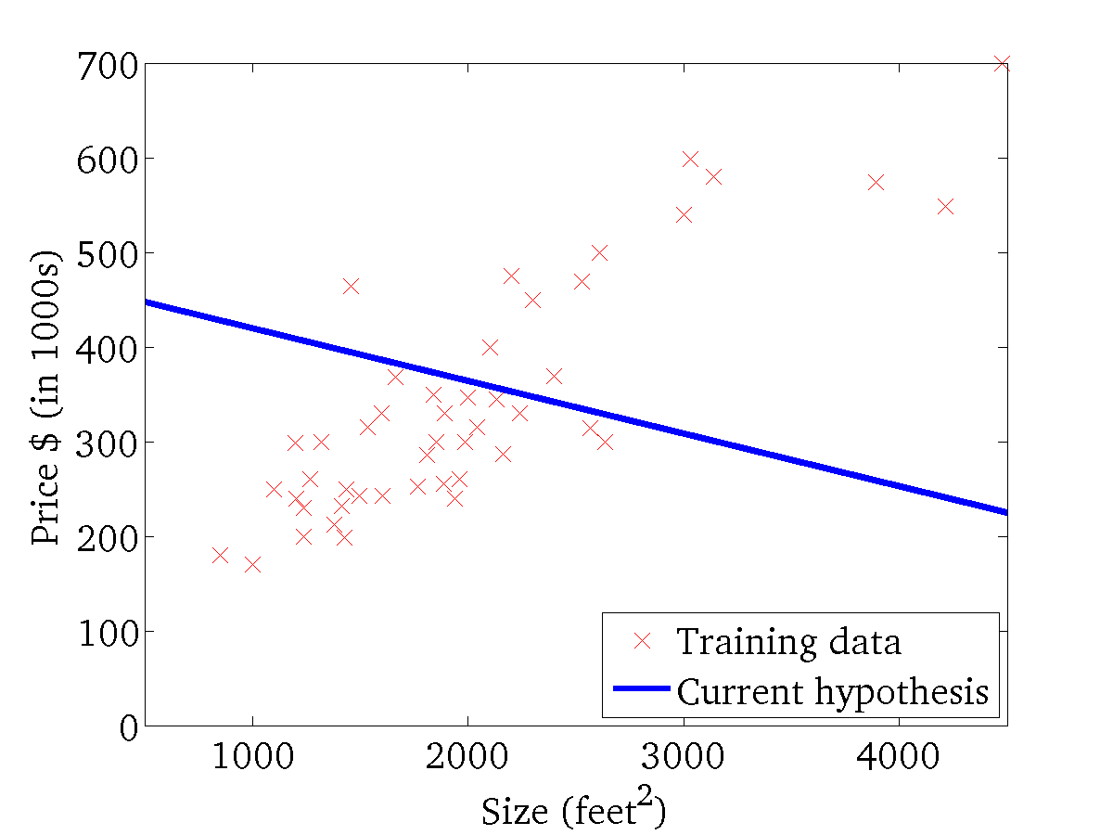

(for fixed , this is a function of x)
(function of the parameters )

Slide 20
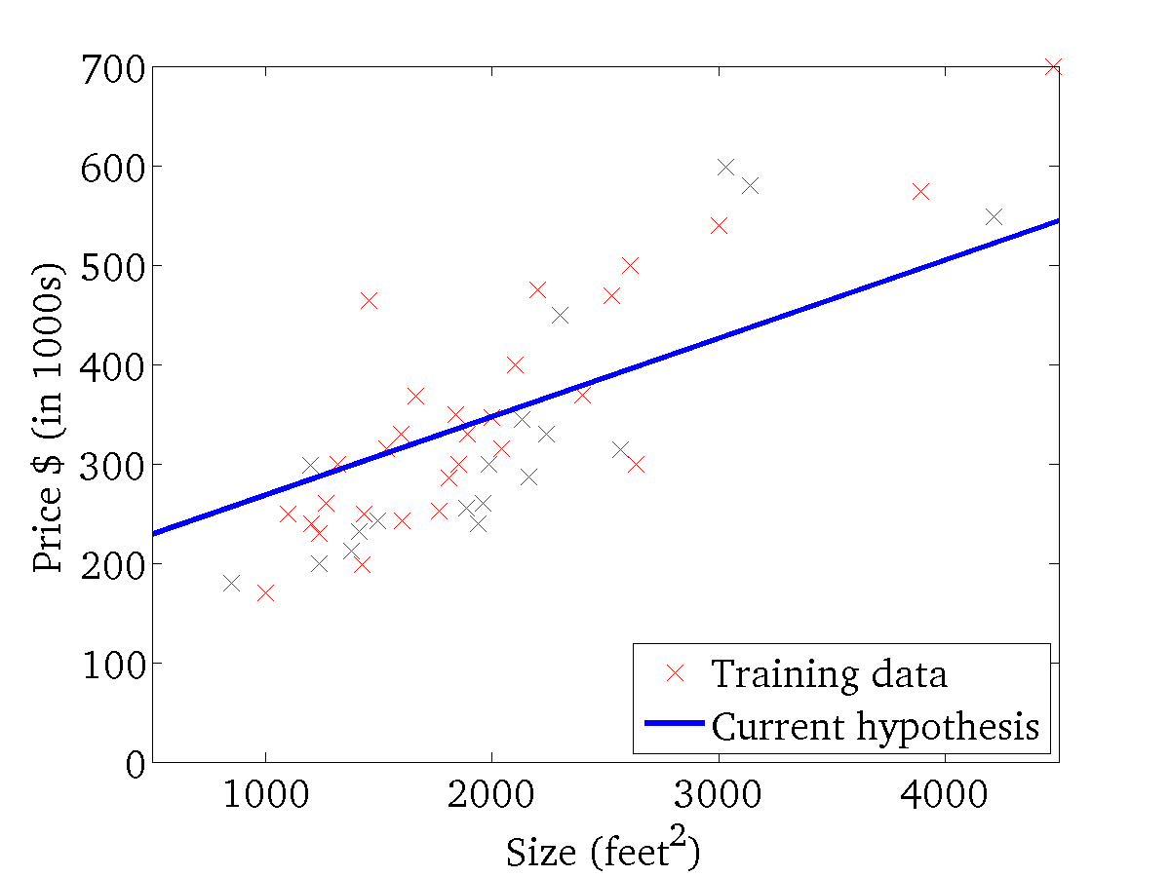
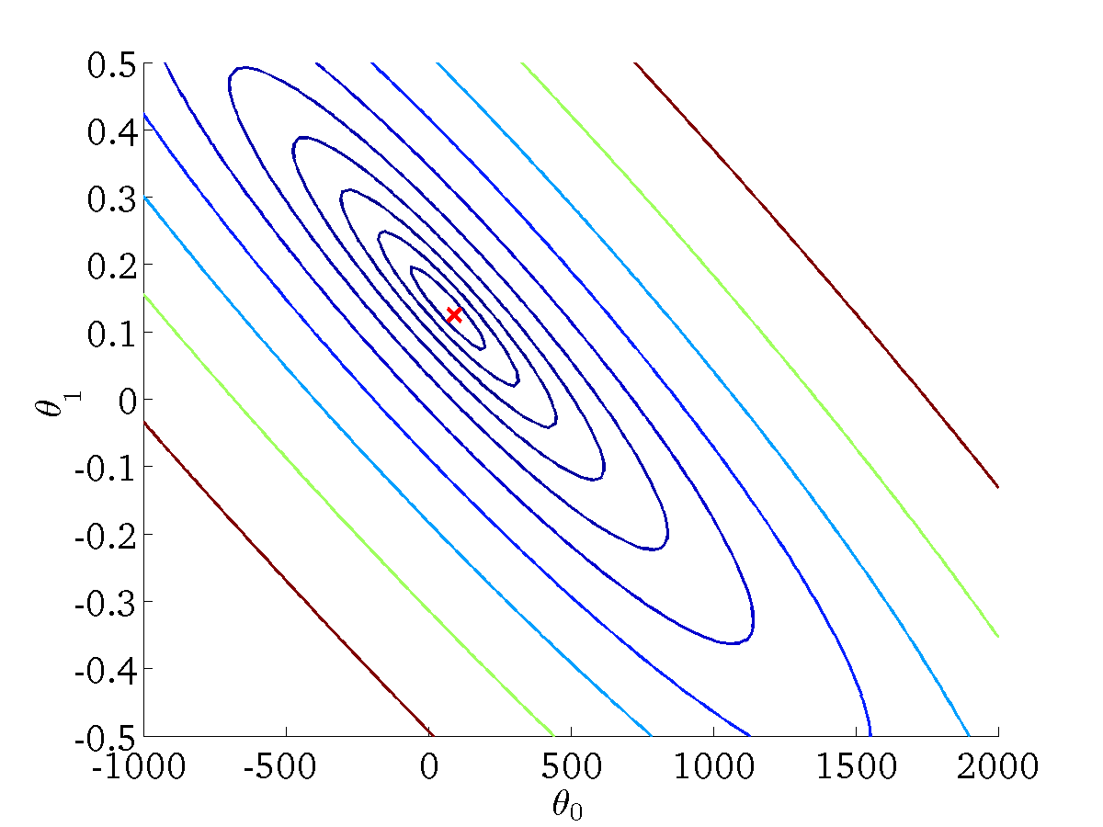
(for fixed , this is a function of x)
(function of the parameters )

Slide 21
Gradient descent
Linear regression with one variable
Machine Learning

Slide 22
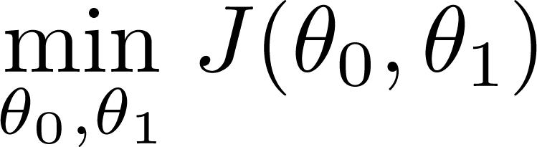
Have some function
Want
Outline:
Start with some
Keep changing to reduce until we hopefully end up at a minimum

Slide 23
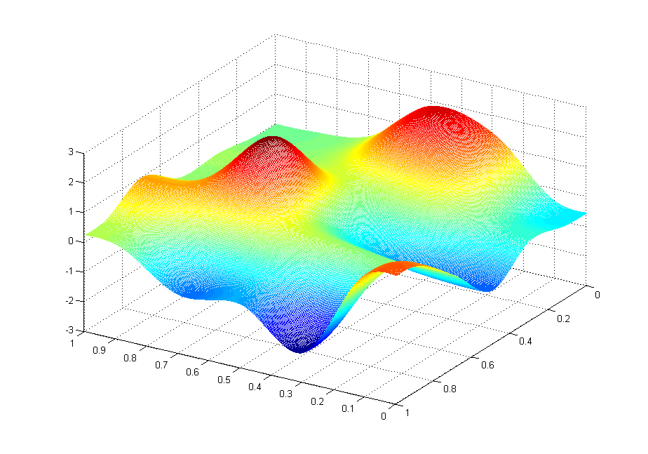
J(θ₀,θ₁)
θ₁
θ₀

Slide 24
J(θ₀,θ₁)
θ₁
θ₀

Slide 25
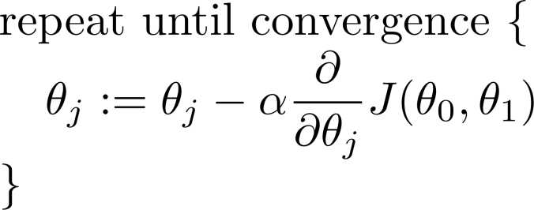
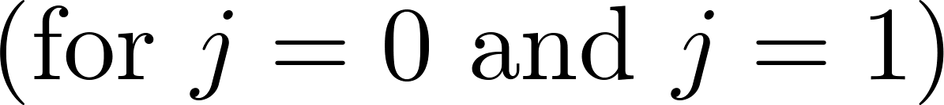
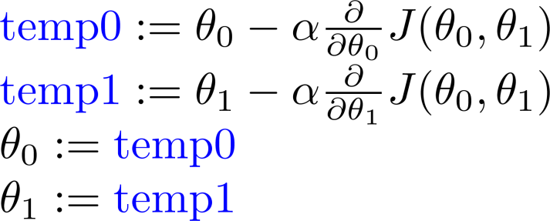
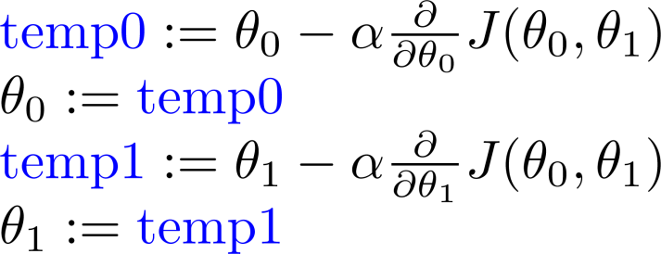
Gradient descent algorithm
Learning rate
Correct: Simultaneous update !
Incorrect:

Slide 26
Gradient descent intuition
Linear regression with one variable
Machine Learning

Slide 27
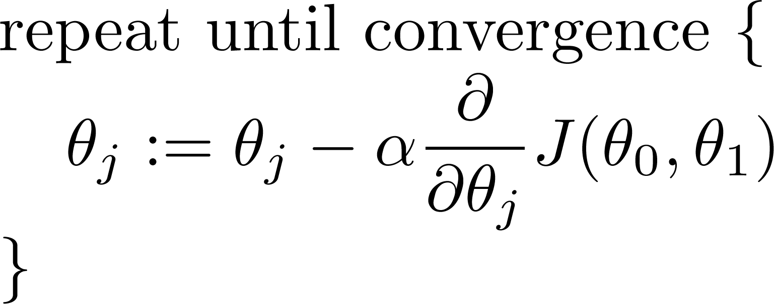
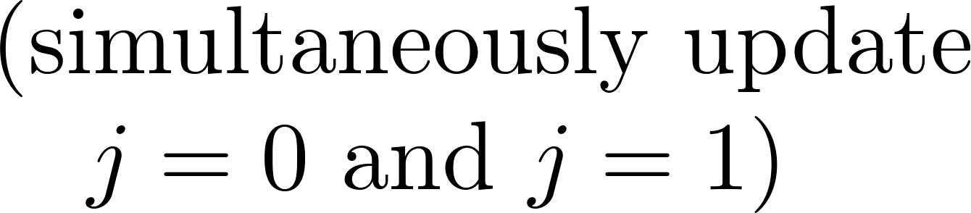
Gradient descent algorithm
Learning rate
Gradient

Slide 28
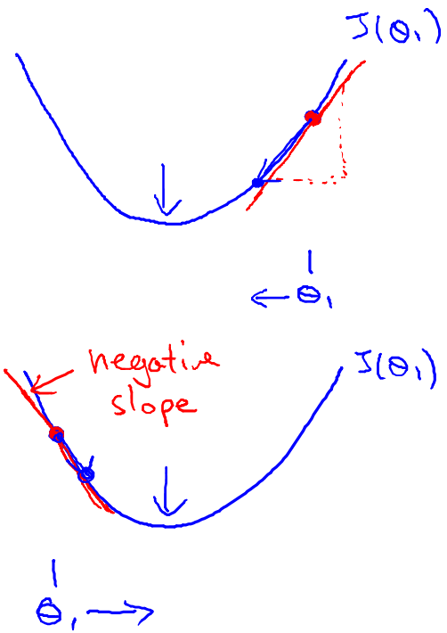

Slide 29
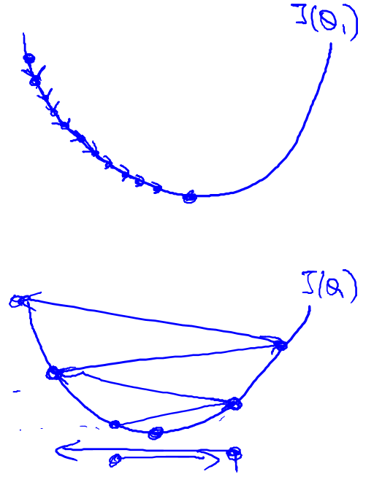
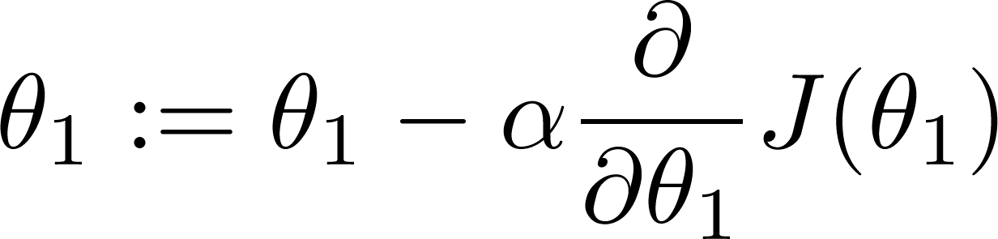
If α is too small, gradient descent can be slow.
If α is too large, gradient descent can overshoot the minimum. It may fail to converge, or even diverge.

Slide 30
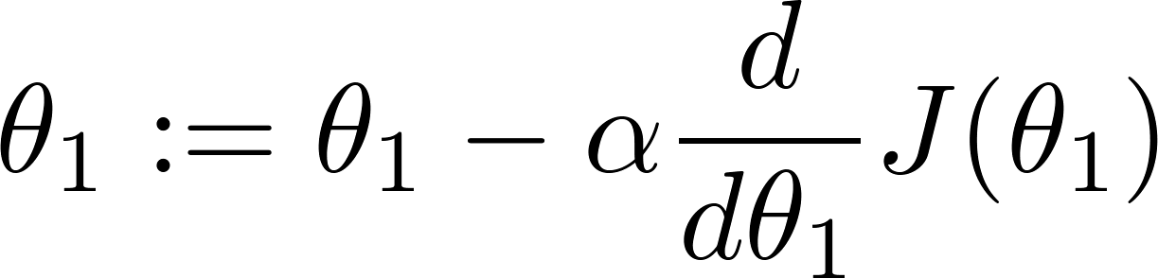
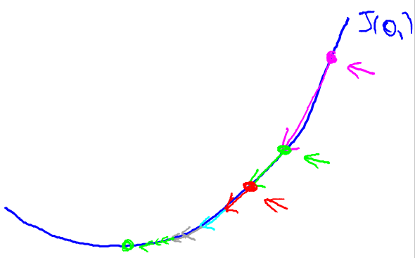
Gradient descent can converge to a local minimum, even with the learning rate α fixed.
As we approach a local minimum, gradient descent will automatically take smaller steps. So, no need to decrease α over time.

Slide 31
Gradient descent for linear regression
Linear regression with one variable
Machine Learning

Slide 32
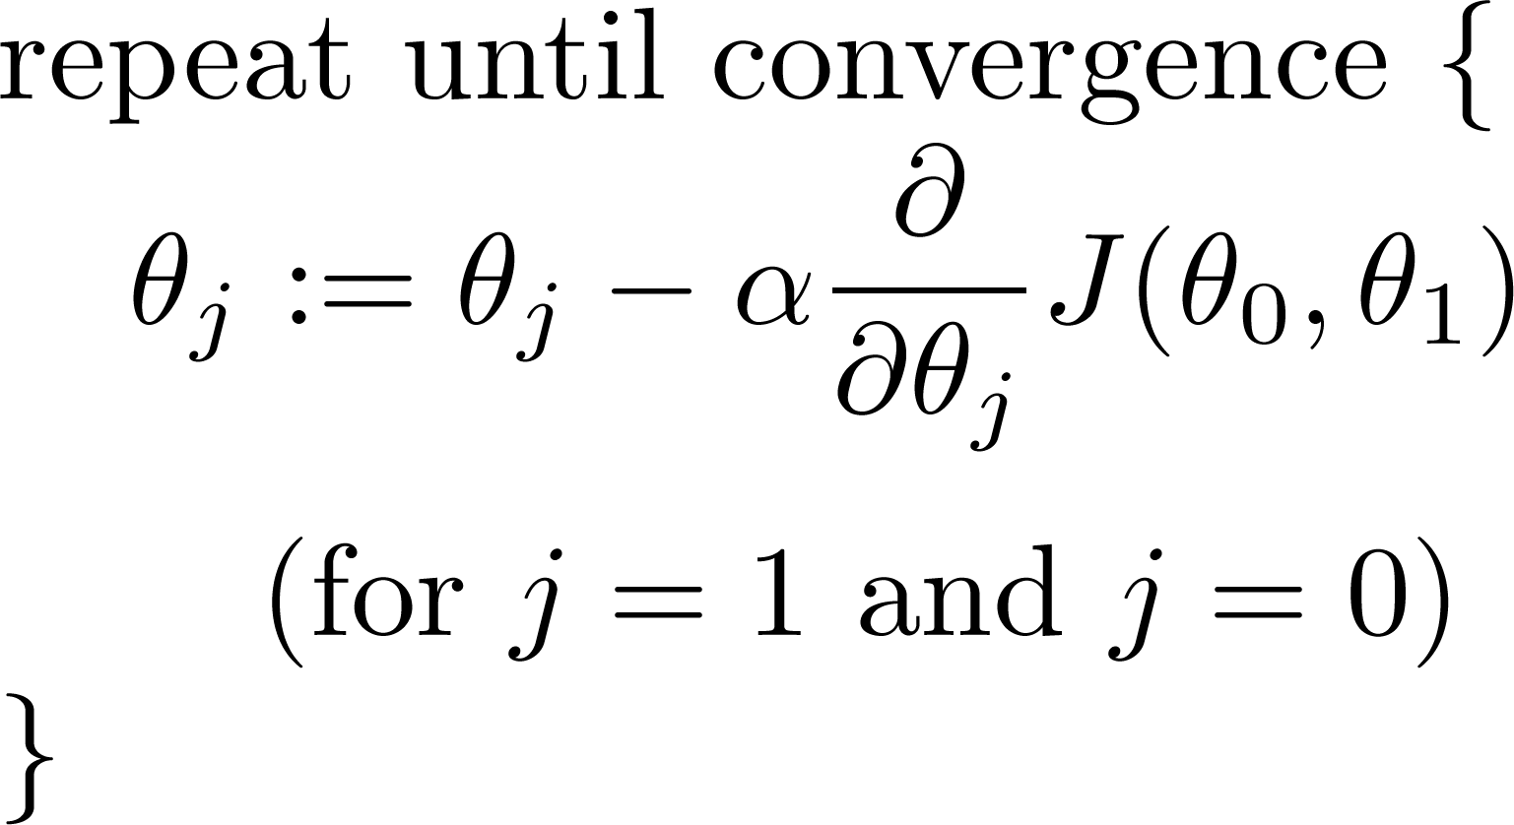
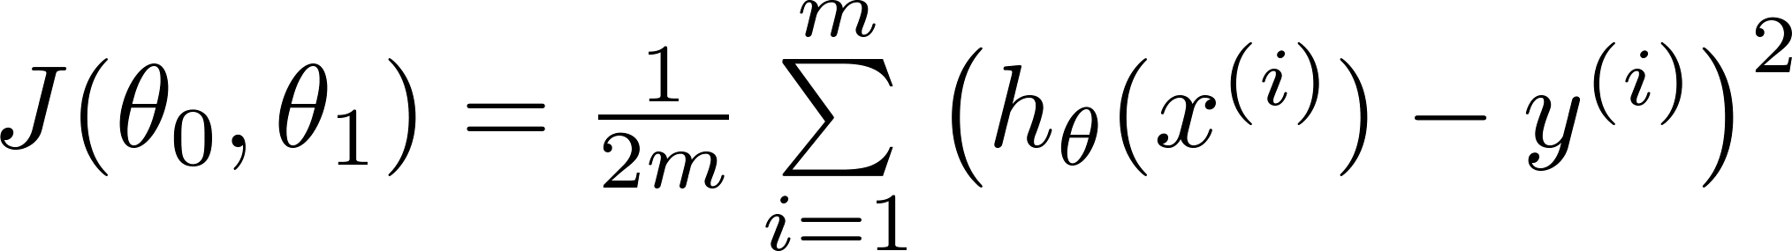
Gradient descent algorithm
Linear Regression Model

Slide 33
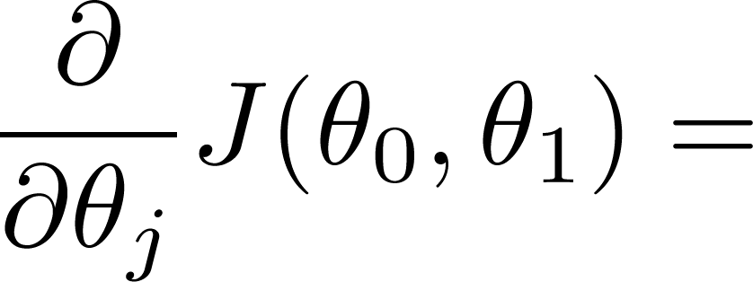
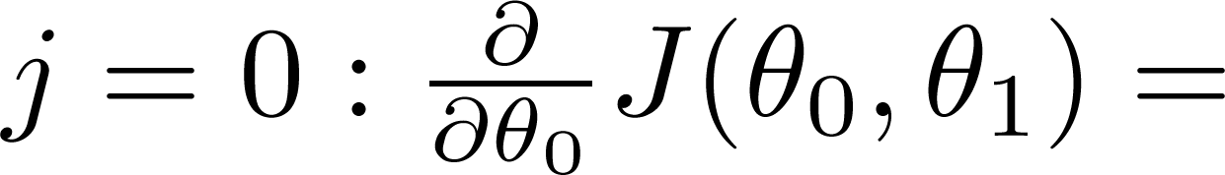
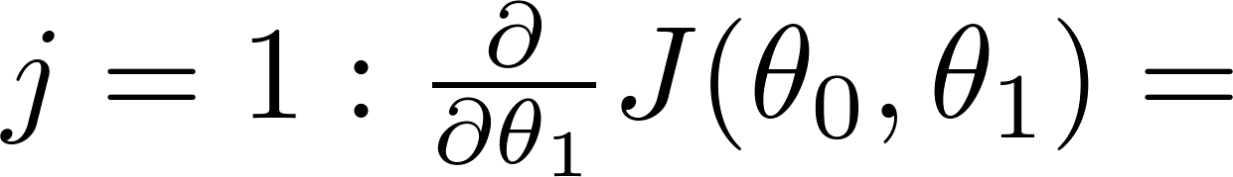

Slide 34
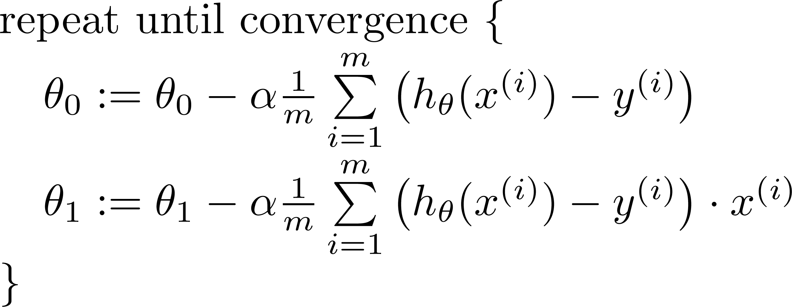

Gradient descent algorithm
update
and
simultaneously

Slide 35
“Batch” Gradient Descent
“Batch”: Each step of gradient descent uses all the training examples.

Slide 36
Non-convex function
J(θ₀,θ₁)
θ₁
θ₀

Slide 37
Convex function

Slide 38
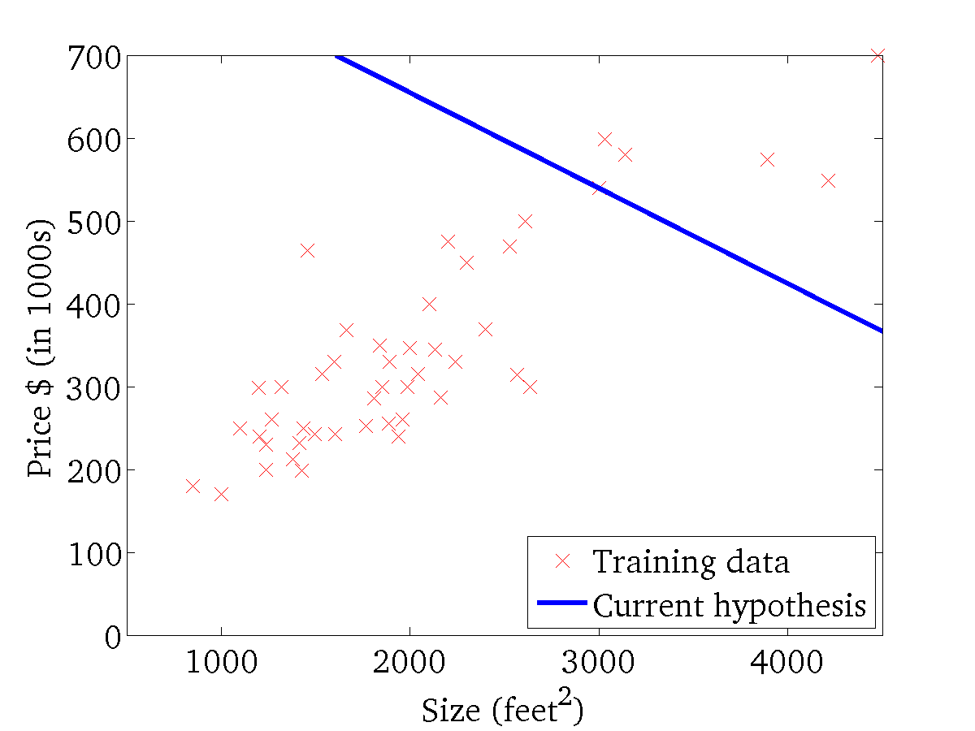
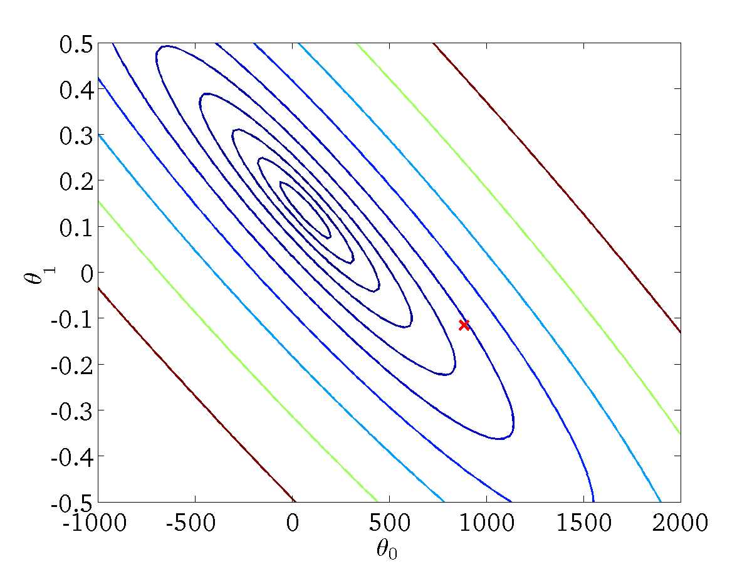
(for fixed , this is a function of x)
(function of the parameters )

Slide 39

(for fixed , this is a function of x)
(function of the parameters )

Slide 40
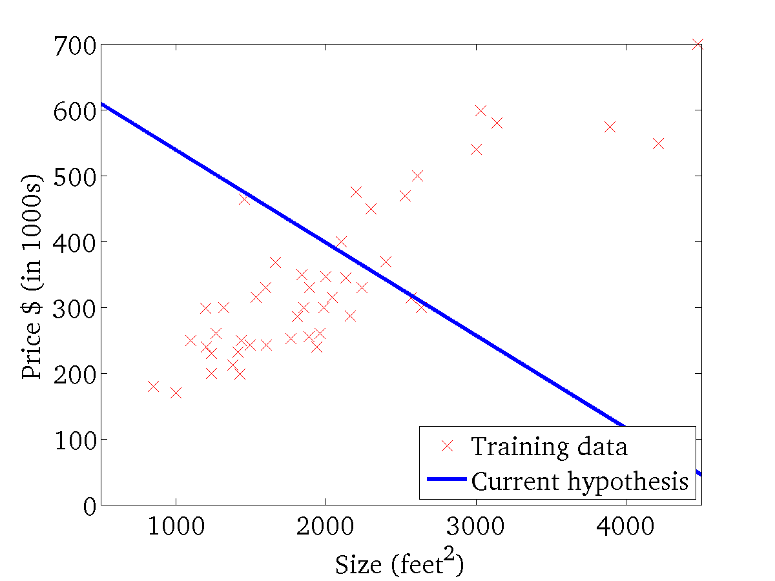
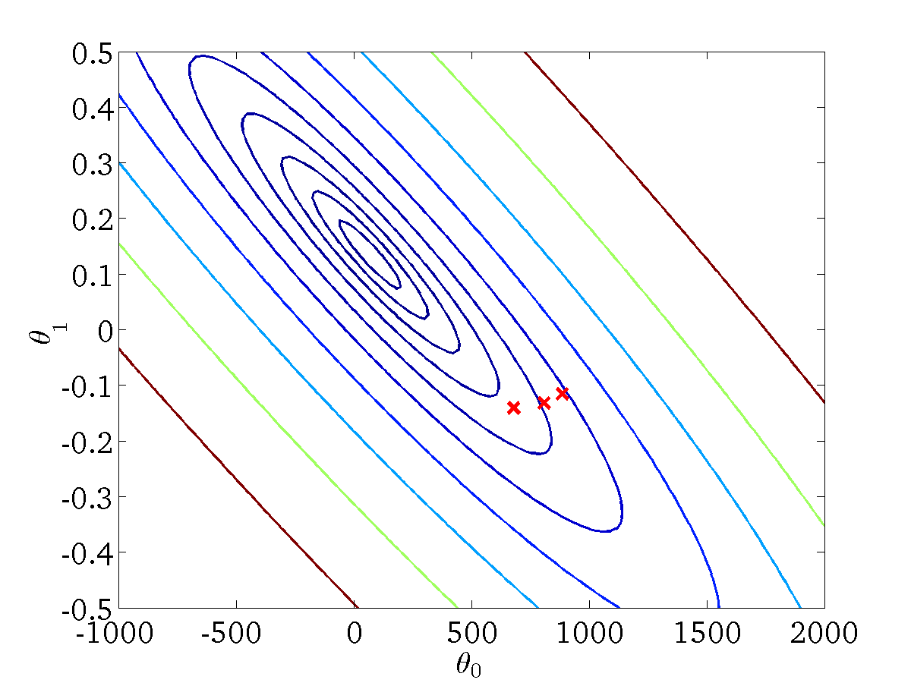
(for fixed , this is a function of x)
(function of the parameters )

Slide 41
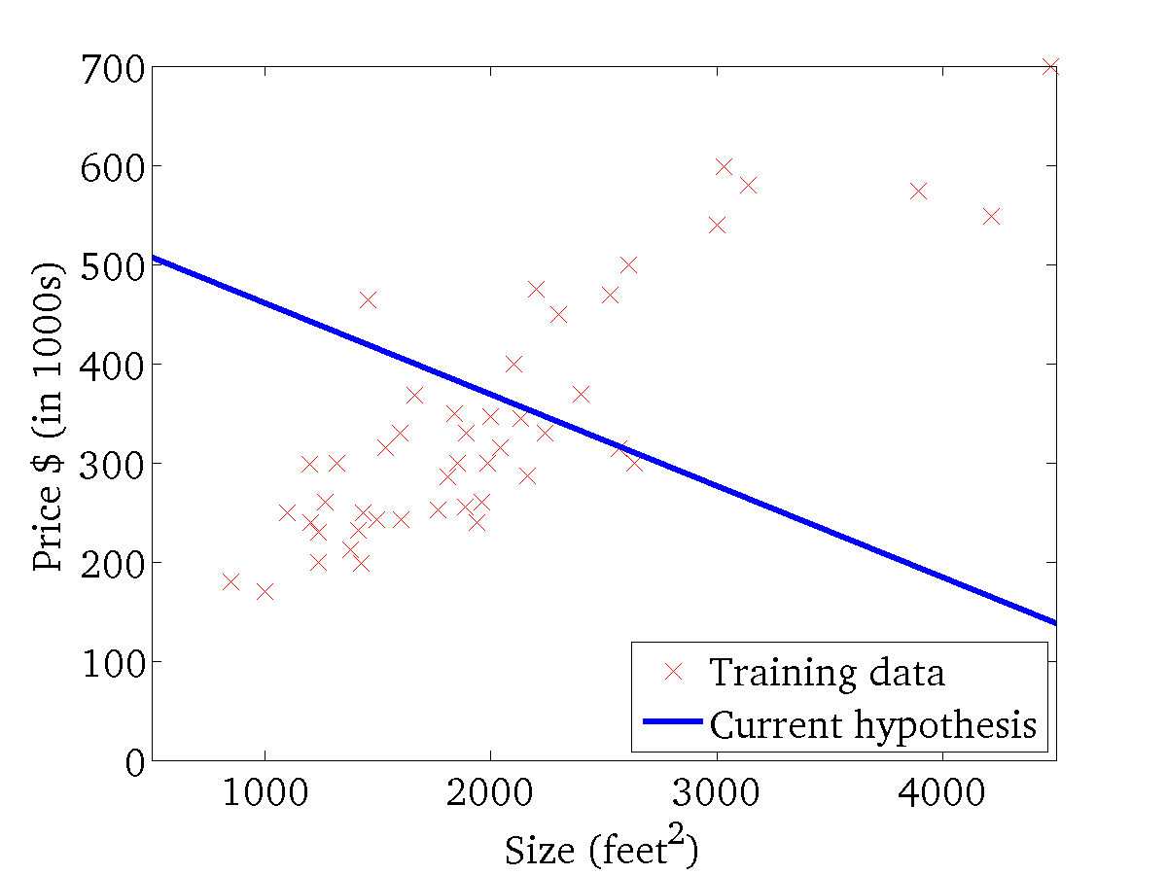

(for fixed , this is a function of x)
(function of the parameters )

Slide 42
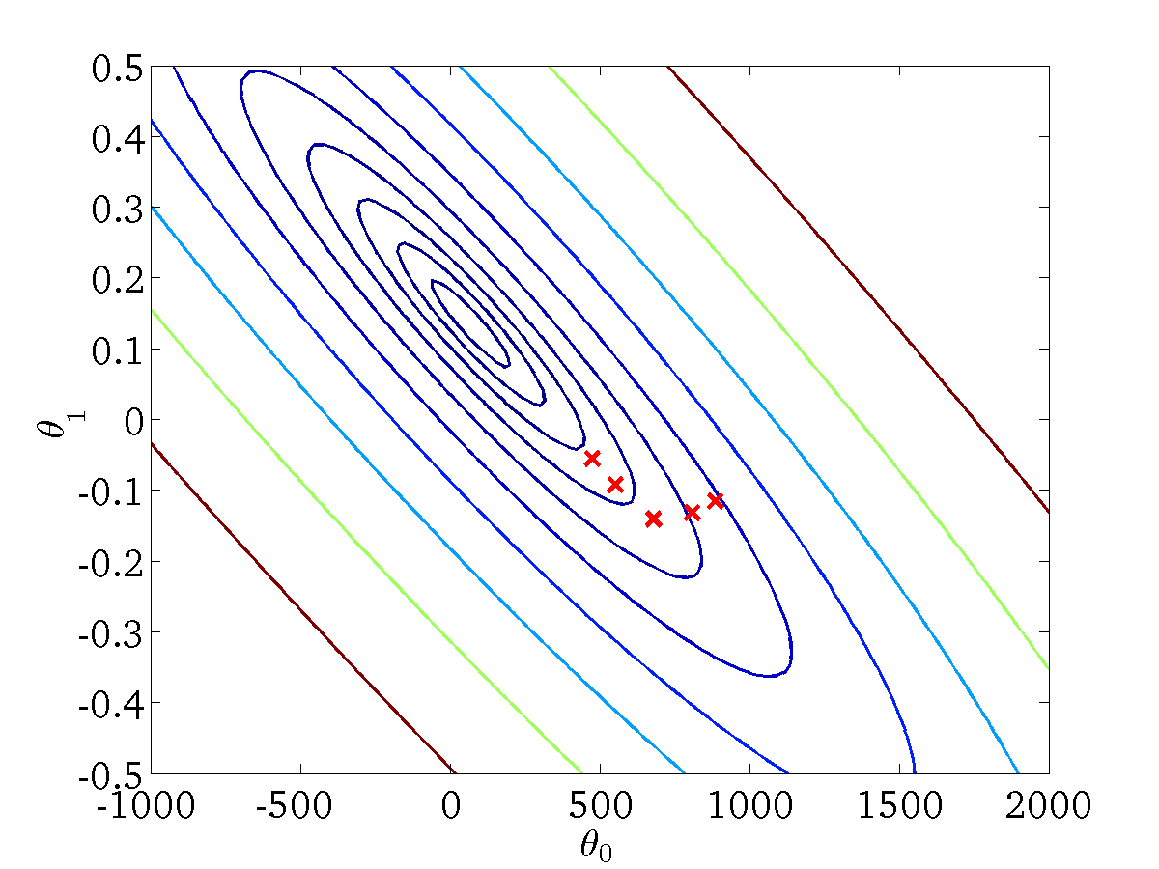
(for fixed , this is a function of x)
(function of the parameters )

Slide 43

(for fixed , this is a function of x)
(function of the parameters )

Slide 44
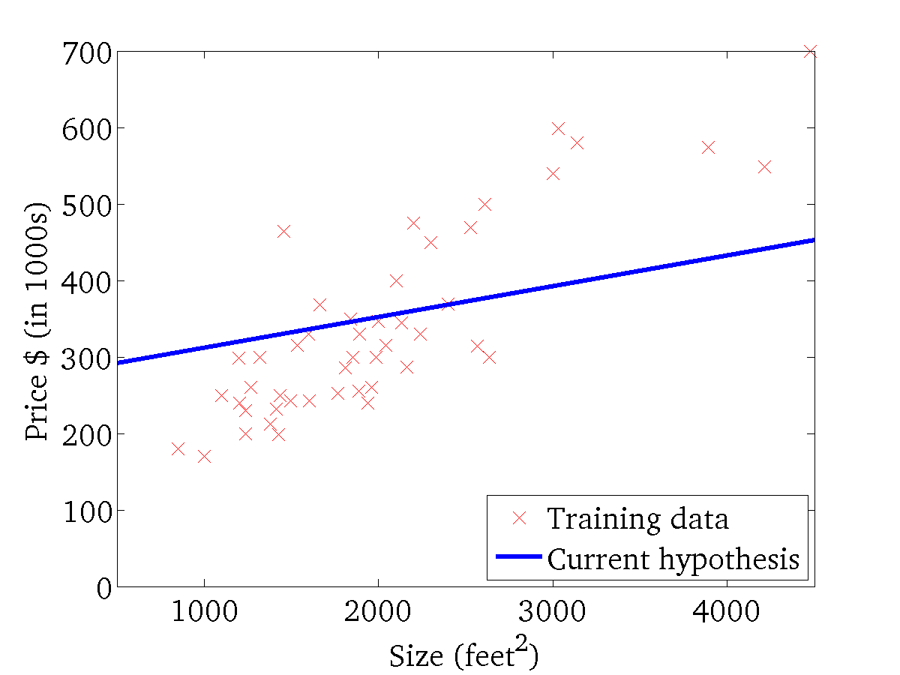

(for fixed , this is a function of x)
(function of the parameters )

Slide 45
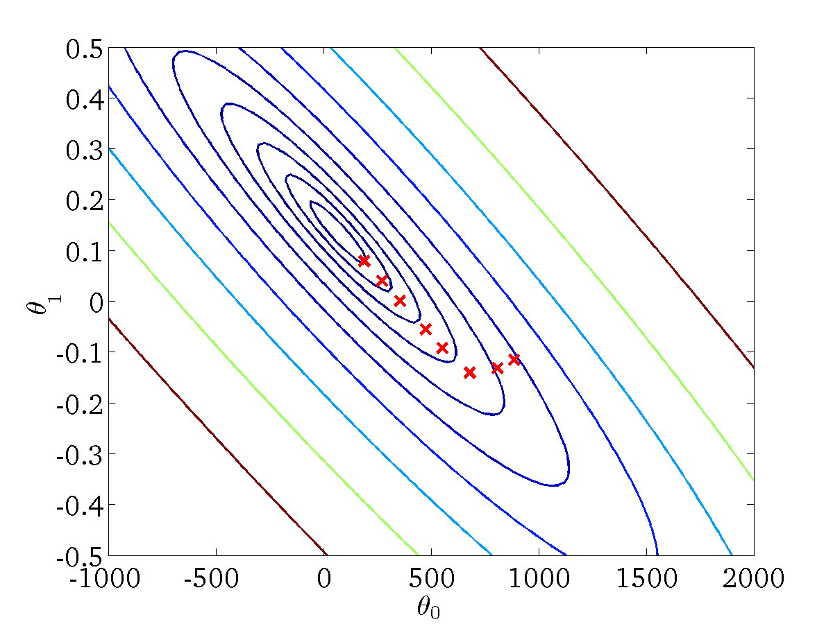
(for fixed , this is a function of x)
(function of the parameters )

Slide 46


(for fixed , this is a function of x)
(function of the parameters )

